Slide 1
White box testing types
Data flow testing

Slide 2
White Box Testing Types:
Data flow testing
Form:
country: India--→Database stored
User Profile
country filter at search

Slide 3
Control Flow Testing:
E-N+2*P
E=edges
N=Nodes
P

Slide 4
Branch coverage
should cover all the branches in minimum test cases.

Slide 5
Statement coverage
test data where statement coverage is maximum

Slide 6
Decision Coverage
All the possible combinations of T and F must be tested
4 test cases

Slide 7
_{8-7+2*2=5}
1,2,4,5,6,8
1,2,4,5,7
1,3,5,7
1,3,5,6,8

Slide 8
Data Flow Testing
Data Flow Testing is a type of structural testing. It is a method that is used to
find the test paths of a program according to the locations of definitions and
uses of variables in the program. It has nothing to do with data flow diagrams. It is concerned with:
Statements where variables receive values,
Statements where these values are used or referenced.
To illustrate the approach of data flow testing, assume that each statement in the program assigned a unique statement number.
For a statement number S-
DEF(S) = {X | statement S contains the definition of X} USE(S) = {X | statement S contains the use of X}
If a statement is a loop or if condition then its DEF set is empty and USE set is based on the condition of statement s.
Data Flow Testing uses the control flow graph to find the situations that can interrupt the flow of the program. Reference or define anomalies in the flow of the data are detected at the time of associations between values and variables. These anomalies are:

Slide 9
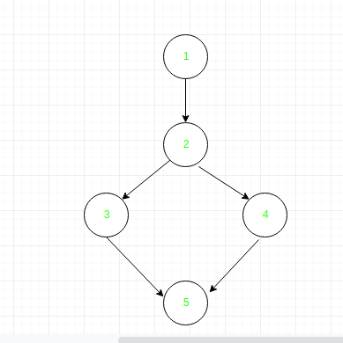
E-N+2(P)=5-5+2(1)=2
read x, y;
if(x>y)
a = x+1 else
a = y-1
print a;

Slide 10
read x, y;
if(x>y)
a = x+1 else
a = y-1
print a;
Define/use of variables of above example:
Variable | Defined at node | Used at node
x | 1 | 2, 3
y | 1 | 2, 4
a | 3, 4 | 5
x,y variable are determining the flow
a is dependent on x,y

Slide 11
Zomato
signup form phonenumber defined
profile
messages
restaurant owner
delivery guy
Change phoneNumber:

Slide 12
Exercise Question:Day2 21st Feb
input x,y x=5,y=2
if x+y is positive 3 /8
print x*y x=10,y=-12
else 4 /8
if y is non-zero
print x/y
else
print x

Slide 13
Control Flow Testing
Control flow testing is a type of software testing that uses program’s control flow as a model. Control flow testing is a structural testing strategy. This testing technique comes under white box testing. For the type of control flow testing, all the structure, design, code and implementation of the software should be known to the testing team.
This type of testing method is often used by developers to test their own code and own implementation as the design, code and the implementation is better known to the developers. This testing method is implemented with the intention to test the logic of the code so that the user requirements can be fulfilled. Its main application is to relate the small programs and segments of the larger programs.

Slide 14
In the above cyclomatic complexity is 2=1,2,3,5 and 1,2,4,5
Control Flow Graph: Control Flow Graph is a graphical representation of control flow or computation that is done during the execution of the program.
Control flow graphs are mostly used in static analysis as well as compiler applications,
as they can accurately represent the flow inside of a program unit.
Control flow graph was originally developed by Frances E. Allen.
Cyclomatic Complexity: Cyclomatic Complexity is the quantitative measure of the number of linearly independent paths in it.
It is a software metric used to describe the complexity of a program.
It is computed using the Control Flow Graph of the program.
M = E - N + 2P
E =number of edges
N= number of nodes
P=number of connected components
2=5-5+2*1

Slide 15
left shift
The focus of the entire team is to find, detect and fix the bugs as early as possible during the development cycle.

Slide 16
It detects almost half of the defects that are determined during the unit testing.
It also determines almost one-third of the defects of the whole program.
It can be performed manually or automated as the control flow graph that is used can be made by hand or by using software also.

Slide 17
3 numbers: largest of 3 numbers

Slide 18
Branch Coverage Testing
Branch coverage technique is used to cover all branches of the control flow graph. It covers all the possible outcomes (true and false) of each condition of decision point at least once. Branch coverage technique is a whitebox testing technique that ensures that every branch of each decision point must be executed.
However, branch coverage technique and decision coverage technique are very similar, but there is a key difference between the two. Decision coverage technique covers all branches of each decision point whereas branch testing covers all branches of every decision point of the code.

Slide 19
In the above diagram, control flow graph of code is depicted. In the first case traversing through "Yes "decision, the path is A1-B2-C4-D6-E8, and the number of covered edges is 1, 2, 4, 5, 6 and 8 but edges 3 and 7 are not covered in this path. To cover these edges, we have to traverse through "No" decision. In the case of "No" decision the path is A1-B3-5-D7, and the number of covered edges is 3 and 7. So by traveling through these two paths, all branches have covered. Path 1 - A1-B2-C4-D6-E8 Path 2 - A1-B3-5-D7 Branch Coverage (BC) = Number of paths =2

Slide 20
Branch coverage: scenario
Airbnb
currency change
default currency------→country
10 currency-----→change across the site

Slide 21
In the above diagram, control flow graph of code is depicted. In the first case traversing through "Yes "decision,
the path is A1-B2-C4-D6-E8, and the number of covered edges is 1, 2, 4, 5, 6 and 8 but edges 3 and 7 are not covered in this path.
To cover these edges, we have to traverse through "No" decision. In the case of "No" decision the path is A1-B3-5-D7,
and the number of covered edges is 3 and 7. So by traveling through these two paths, all branches have covered.
Path 1 - A1-B2-C4-D6-E8 Path 2 - A1-B3-5-D7 Branch Coverage (BC) = Number of paths =2

Slide 22
Statement Coverage Testing
It is one type of white box testing technique that ensures that all the statements of the source code are executed at least once.
It covers all the paths, lines, and statements of a source code.
It is used to design test box cases where it will find out the total number of executed statements out of the total statements present in the code.
Formula:
Statement coverage = (Number of executed statements / Total number of statements in source code) * 100

Slide 23
Read A Read B if A > B Print “A is greater than B” else Print “B is greater than A” endif
If A = 10, B= 5
No of statements Executed= 5
Total statements= 7
Statement coverage= 5 / 7 * 100 = 71.00 %

Slide 24
If A = 7, B= 3
No of statements Executed= 5
Total statements= 7
Statement coverage= 5 / 7 * 100 = 71.00 %

Slide 25
a=10, b =12
1)Read A 2)Read B 3)if A > B 4) Print “A is greater than B” 5)else 6)Print “B is greater than A” 7)endif
6/7*100

Slide 26
Question statement coverage
read a
read b
if a==b
print equal
if a>b
print greater
else
print smaller
end
total=9
a=3, b=3
executed=5
5/9*100

Slide 27
Decision Coverage Testing
Decision coverage or Branch coverage is a testing method, which aims to ensure that each one of the possible branch from each decision point is executed at least once and thereby ensuring that all reachable code is executed.
That is, every decision is taken each way, true and false. It helps in validating all the branches in the code making sure that no branch leads to abnormal behavior of the application.

Slide 28
Read A
Read B
IF A+B > 10 THEN Print "A+B is Large“ ENDIF
If A > 5 THEN Print "A Large" ENDIF

Slide 29
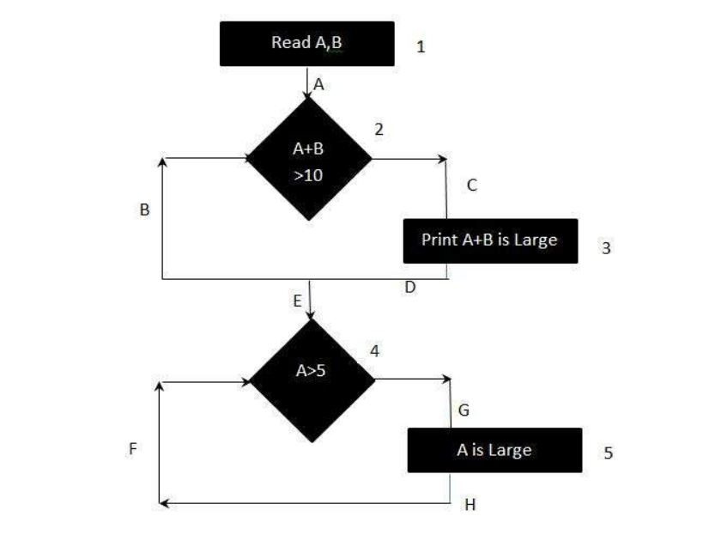
Decision coverage=minimum independent paths that must be executed so that all possible outcomes are tested=4

Slide 30
Writing loops in CFG
read n, i=1
while i<=n
print I
i=i+1

Slide 31
What would you use in case of loops? Decision coverage or branch coverage
Decision coverage

Slide 32
n=12
1
2
3
4
5
6
7
8
9
10
11
12

Slide 33
To calculate Branch Coverage, one has to find out the minimum number of paths which will ensure that all the edges are covered.
In this case there is no single path which will ensure coverage of all the edges at once. The aim is to cover all possible true/false decisions. (1) 1A-2C-3D-E-4G-5H (2) 1A-2B-E-4F Hence Decision or Branch Coverage is 2.

Slide 34
23rd April
Statement coverage
Branch coverage vs decision coverage
:loop example
left shift
cyclomatic complexity
…………………………………
continuation point for tom.
What is the difference between branch coverage and decision coverage
QA vs QC?

Slide 35
Black box testing
Functionality Testing/Component Testing
Integration Testing
System Testing

Slide 36
SPECIFICATION BASED TECHNIQUES OR BLACK BOX TESTING

Slide 37
Black box testing types
Decision table: Zomato example
Boundary value: Zomato example

Slide 38
BVA:
username 6-13 characters
less than 6
at 6
10 characters
13 character
14 characters

Slide 39
Equivalence class partition
less than 6 character =3
6-13 =10
more than 13 characters= 15

Slide 40
State transition
same input and getting different o/p

Slide 41
Decision Table Technique
Decision tables are used in various engineering fields to represent complex logical relationships. This testing is a very effective tool in testing the software and its requirements management. The output may be dependent on many input conditions and decision tables give a tabular view of various combinations of input conditions and these conditions are in the form of True(T) and False(F). Also, it provides a set of conditions and its corresponding actions required in the testing.

Slide 42
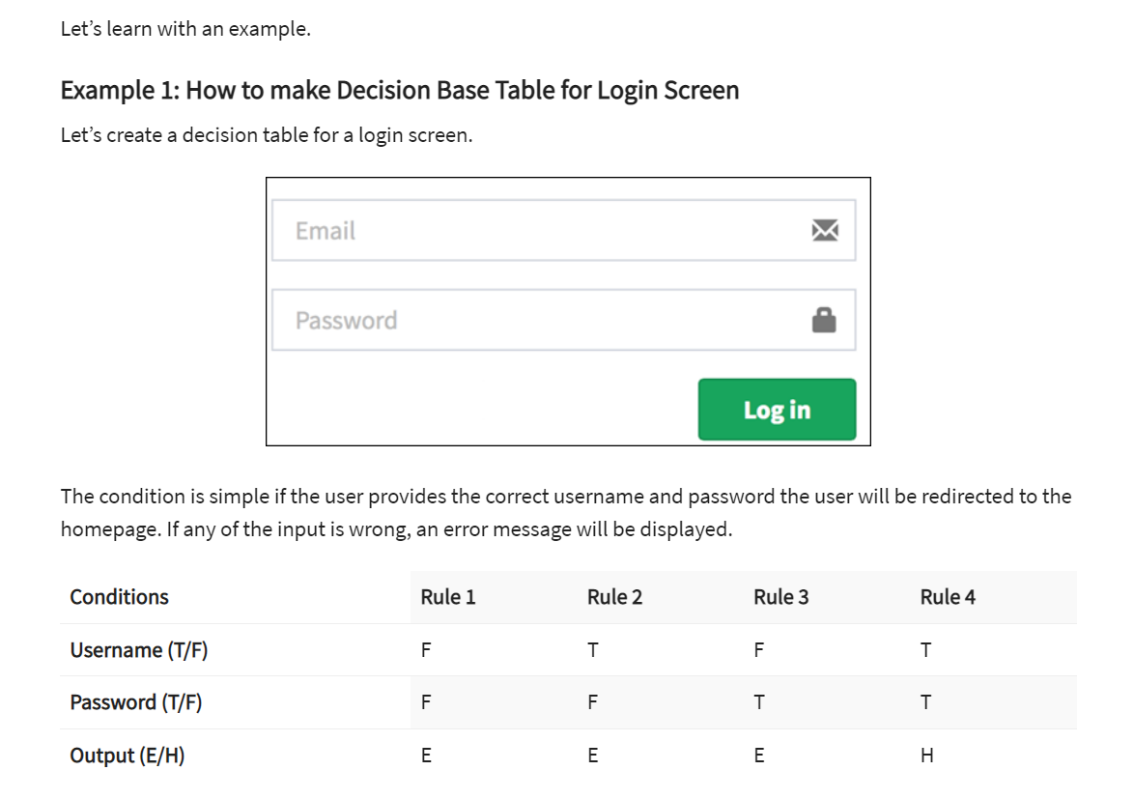

Slide 43
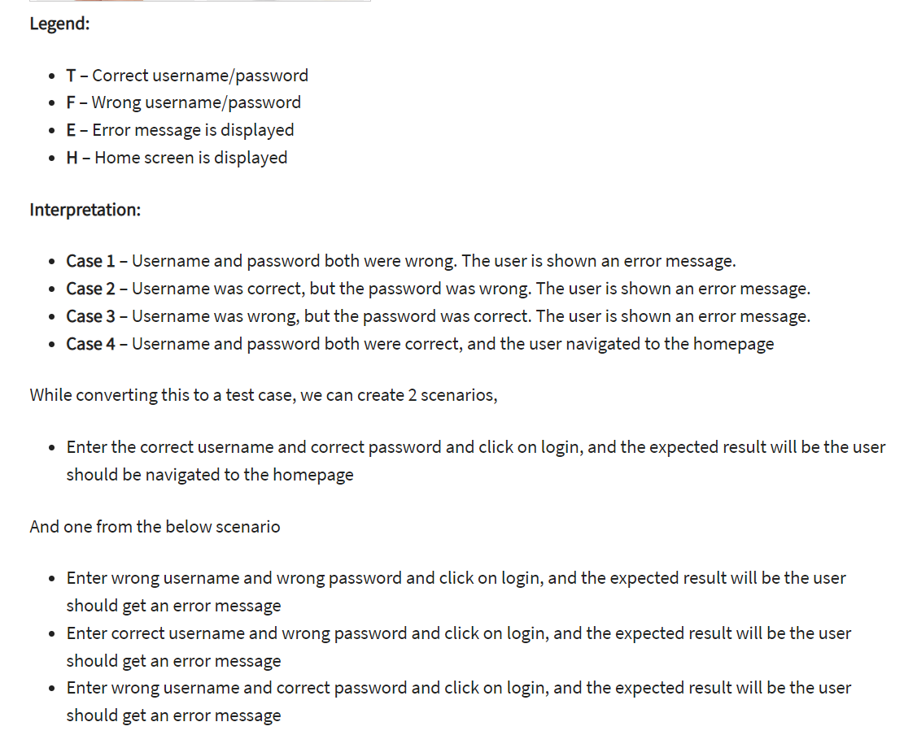

Slide 44
Boundary value Technique
Functional testing is a type of software testing in which the system is tested against the functional requirements of the system. It is conducted to ensure that the requirements are properly satisfied by the application. Functional testing verifies that each function of the software application works in conformance with the requirement and specification. Boundary Value Analysis(BVA) is one of the functional testings.
Boundary Value Analysis
Boundary Value Analysis is based on testing the boundary values of valid and invalid partitions. The behavior at the edge of the equivalence partition is more likely to be incorrect than the behavior within the partition, so boundaries are an area where testing is likely to yield defects.
It checks for the input values near the boundary that have a higher chance of error. Every partition has its maximum and minimum values and these maximum and minimum values are the boundary values of a partition.

Slide 45
Boundary testing is the process of testing between extreme ends or boundaries between partitions of the input values.
So these extreme ends like Start- End, Lower- Upper, Maximum-Minimum, Just Inside-Just Outside values are called boundary values and the testing is called “boundary testing”.
The basic idea in normal boundary value testing is to select input variable values at their:
Minimum
Just above the minimum
A nominal value
Just below the maximum
Maximum

Slide 46
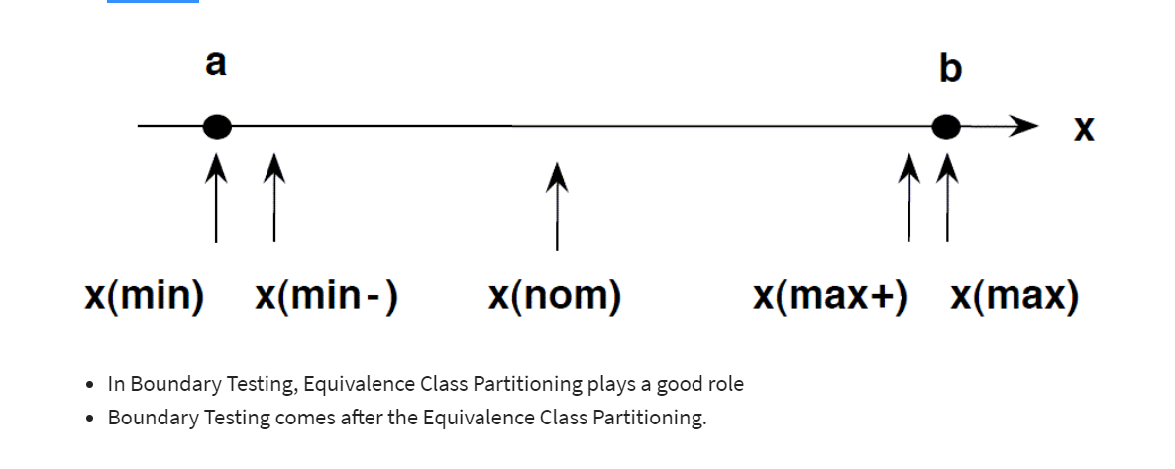

Slide 47
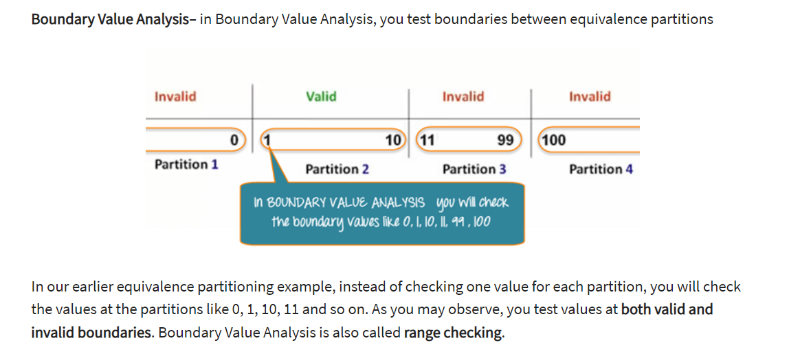

Slide 48
State Transition Technique
State Transition Testing is a black box testing technique in which changes made in input conditions cause state changes or output changes in the Application under Test(AUT). State transition testing helps to analyze behaviour of an application for different input conditions. Testers can provide positive and negative input test values and record the system behavior.
It is the model on which the system and the tests are based. Any system where you get a different output for the same input, depending on what has happened before, is a finite state system.

Slide 49
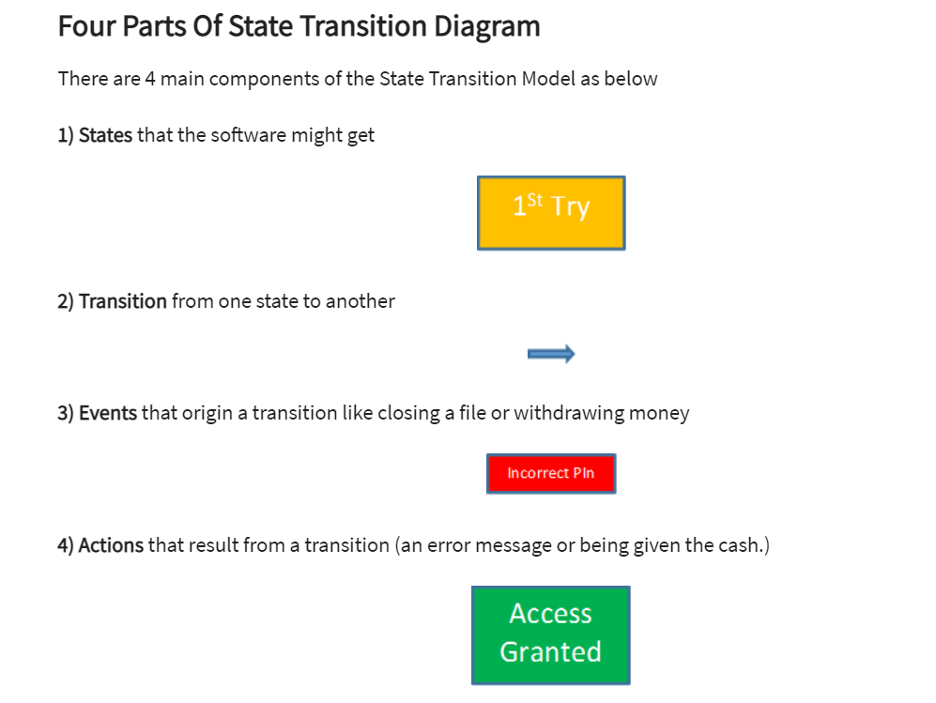

Slide 50
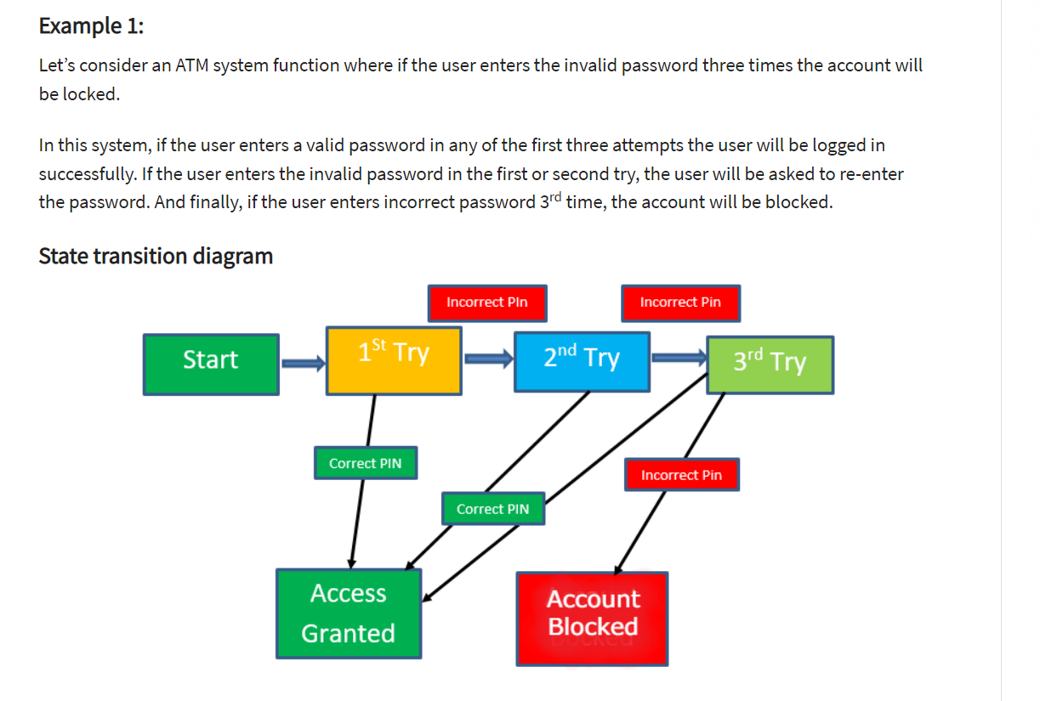

Slide 51
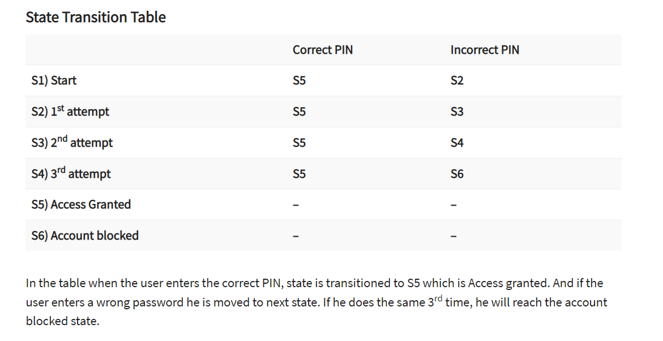

Slide 52
All Pair testing Technique
All-pairs also known as pairwise testing is a testing approach taken for testing the software using combinatorial method. It's a method to test all the possible discrete combinations of the parameters involved.
Assume we have a piece of software to be tested which has got 10 input fields and 10 possible settings for each input field. Then, there are 10^10 possible inputs to be tested. In this case, exhaustive testing is impossible even if we wish to test all combinations.
Let us also understand the concept of All-pairs testing by taking an example.

Slide 53
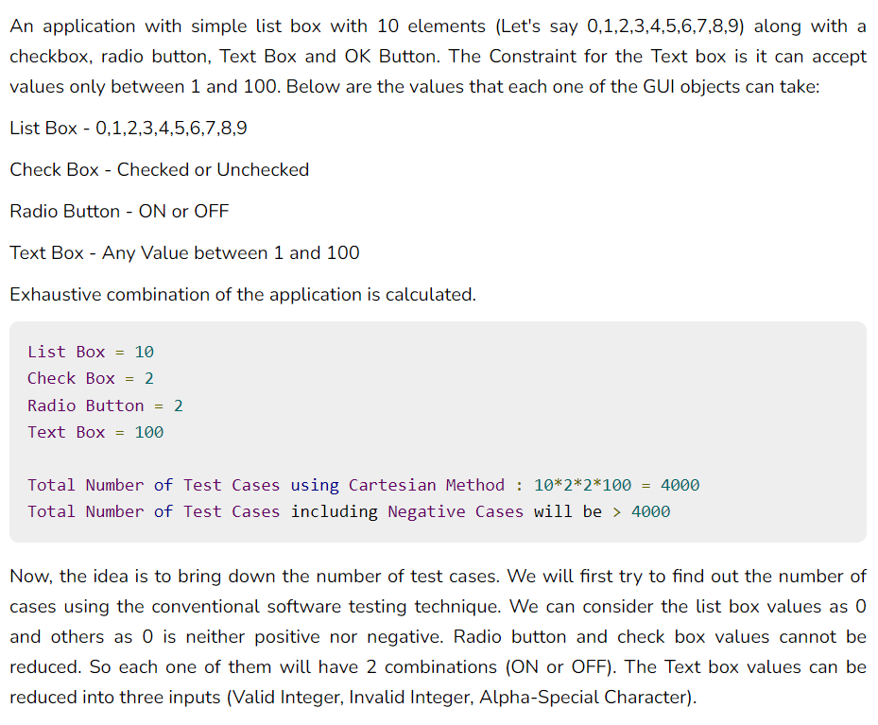

Slide 54
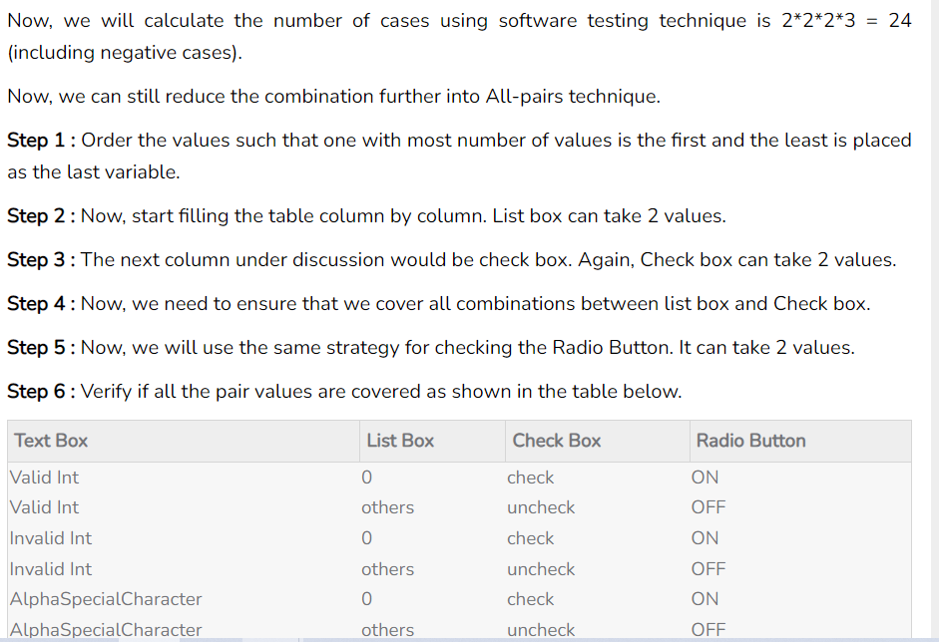

Slide 55
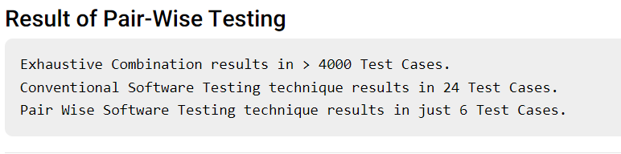

Slide 56
Equivalence Partitioning Technique
Equivalence Partitioning Method is also known as Equivalence class partitioning (ECP). It is a software testing technique or black-box testing that divides input domain into classes of data, and with the help of these classes of data, test cases can be derived. An ideal test case identifies class of error that might require many arbitrary test cases to be executed before general error is observed.
In equivalence partitioning, equivalence classes are evaluated for given input conditions. Whenever any input is given, then type of input condition is checked, then for this input conditions, Equivalence class represents or describes set of valid or invalid states.
Guidelines for Equivalence Partitioning :
If the range condition is given as an input, then one valid and two invalid equivalence classes are defined.
If a specific value is given as input, then one valid and two invalid equivalence classes are defined.
If a member of set is given as an input, then one valid and one invalid equivalence class is defined.
If Boolean no. is given as an input condition, then one valid and one invalid equivalence class is defined.

Slide 57
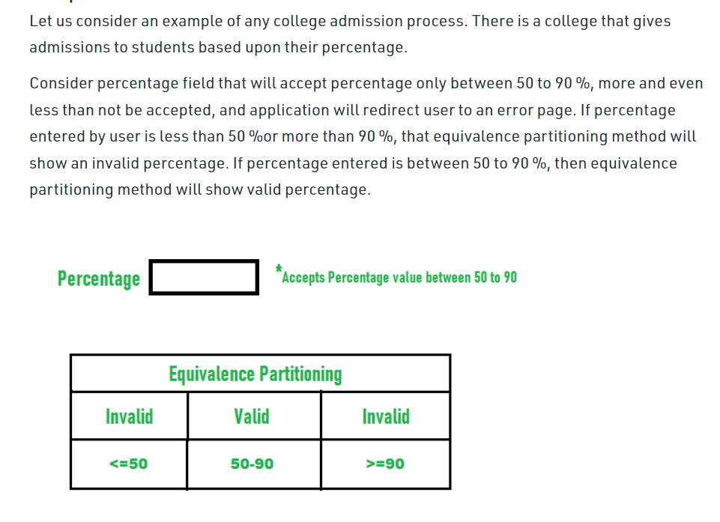

Slide 58
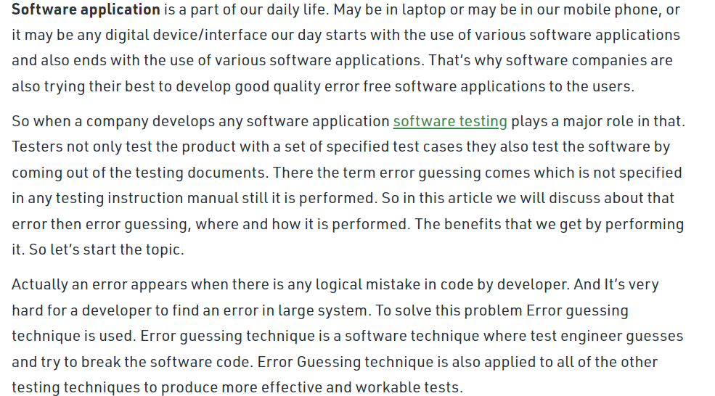
Error Guessing Technique

Slide 59
Where or how to use it ?
Error guessing in software testing approach which is a sort of black box testing technique and also error guessing is best used as a part of the conditions where other black box testing techniques are performed, for instance, boundary value analysis and equivalence split are not prepared to cover all of the condition which are slanted to error in the application.

Slide 60
For Example, if the Analyst guesses that the login page is error-prone, then the testers will write detailed test cases concentrating on the login page. Testers can think of a variety of combinations of data to test the login page.
To design test cases based on the Error Guessing technique, the Analyst can use past experiences to identify the conditions.
This technique can be used at any level of testing and for testing the common mistakes like:
Divide by zero
Entering blank spaces in the text fields
Pressing the submit button without entering values.
Uploading files exceeding maximum limits.
Null pointer exception.
Invalid parameters

Slide 61
UseCase Technique
Use Case Testing is a software testing technique that helps to identify test cases that cover entire system on a transaction by transaction basis from start to end. Test cases are the interactions between users and software application. Use case testing helps to identify gaps in software application that might not be found by testing individual software components.
A Use Case in Testing is a brief description of a particular use of the software application by an actor or user. Use cases are made on the basis of user actions and the response of the software application to those user actions. It is widely used in developing test cases at system or acceptance level.

Slide 62
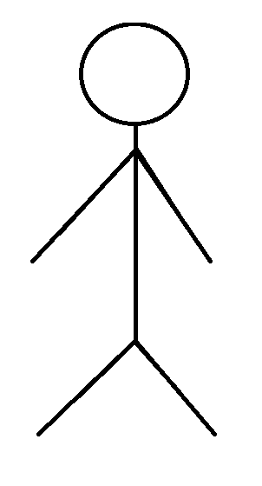
Zomato:customer
order
feedback
payment
tip

Slide 63
Zomato:restaurant owner

Slide 64
Zomato: deliver

Slide 65
Zomato: app

Slide 66
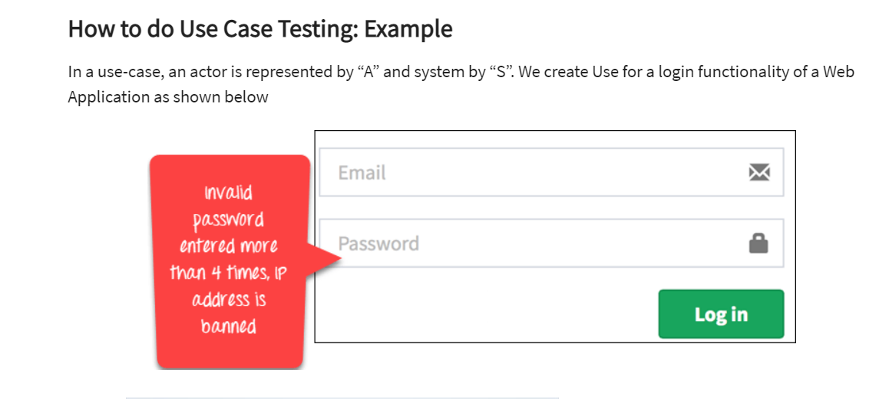

Slide 67
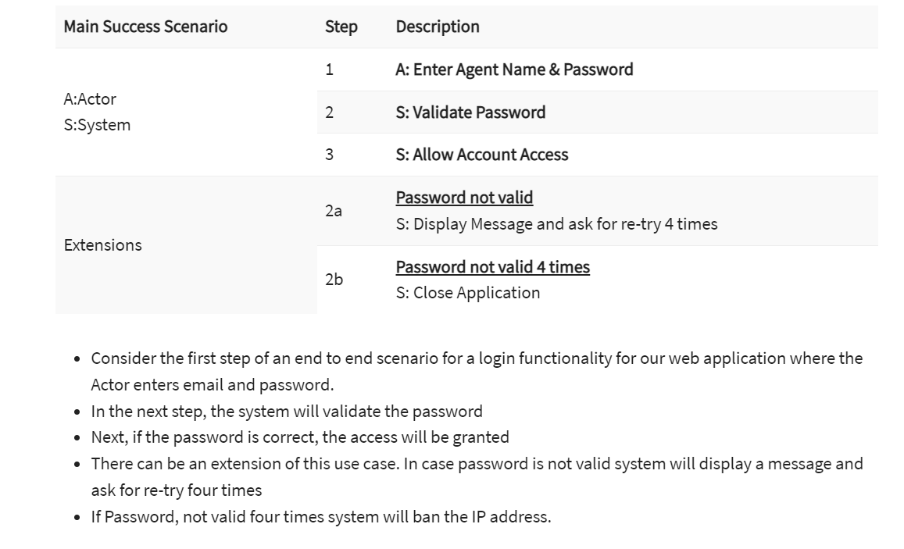

Slide 68
83,97,145,150
presentation evaluation
revision
use case testing
agile methodology
interview questions
sat session discussion

Slide 69
